Slide 1
Module 16
Describing Digital Resources
RDA Training
University of Nevada, Reno
February 2013
Notes:
This module is intended to cover special procedures for digital resources. We’ve already covered thoroughly how to describe other particular formats. We won’t go over all that again, exept to note when you do the same thing for printed music.

Slide 2
Please log in to RDA
http://access.rdatoolkit.org/?username=RDATraining&password=Wolfie13
Reno Workshop: Please feel free to sign up later for a month’s free access so you can practice (see handout)
Notes:
From now on, as I show slides of RDA, please feel free to go ahead and look yourself in the Toolkit.

Slide 3
Mode of Issuance
Single unit monograph?
  Single disc
  Single logical unit (e.g. a PDF file)
Multipart monograph?
Serial?
Integrating resource?
Notes:
This module only covers monographs.

Slide 4
Basis for Identification
RDA 2.1
Single unit monograph
  The item itself
Multipart monograph
  The first unit

Slide 5
Preferred Source of Information
RDA 2.2.2
Choose, in the part chosen as the basis for identification, either
  a label bearing a title that is permanently printed on or affixed to the resource
  or
  embedded metadata in textual form
  If neither is available, use
  another source forming part of the resource itself, preferring a source where the information is formally presented
Notes:
DVD-ROM or CD-ROM: Label is the preferred source. If the label does not include the information you need, you can go to another source forming part of the resource itself, e.g., the container.
Online resource: embedded metadata (including the title screen)

Slide 6
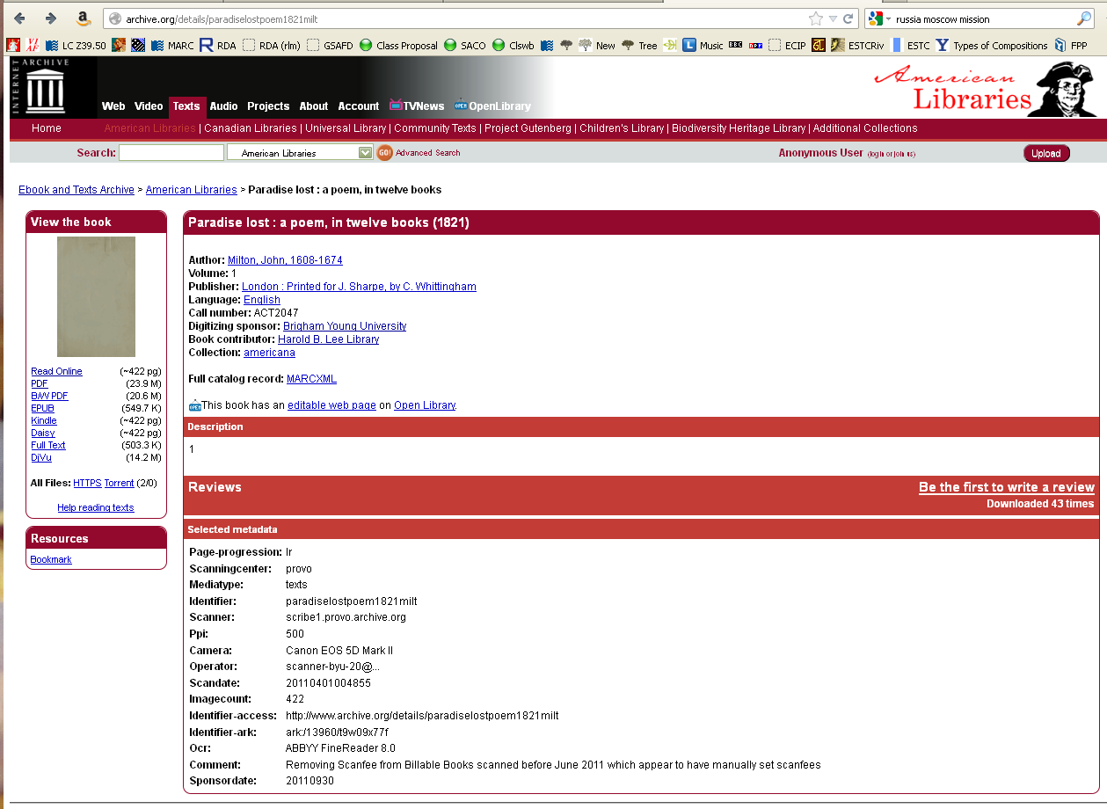
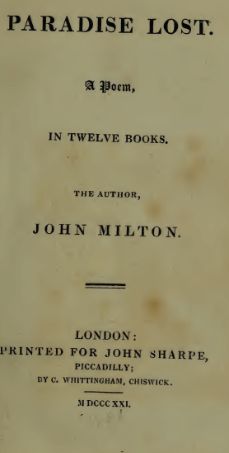
Preferred source?
Notes:
Digital reproduction.
We have the metadata and the PDF title page for this digital book. Which one? Actually either can be used.

Slide 7
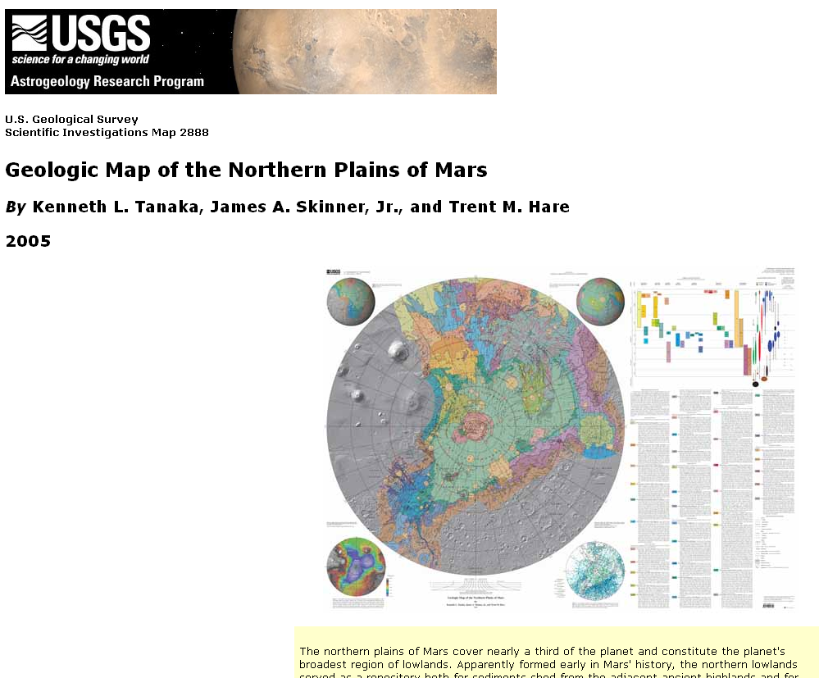
Preferred source
Notes:
Online map

Slide 8
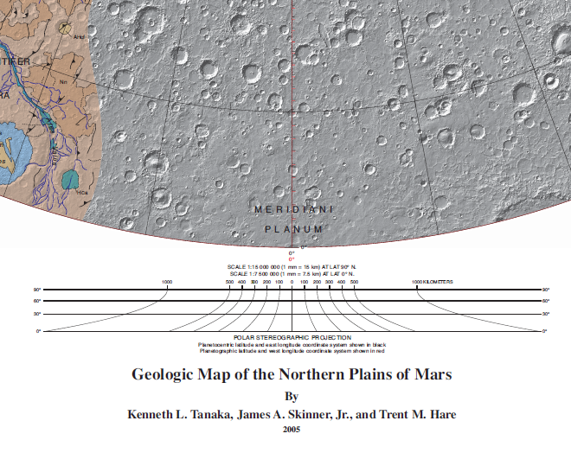
Preferred source
Notes:
Map face

Slide 9
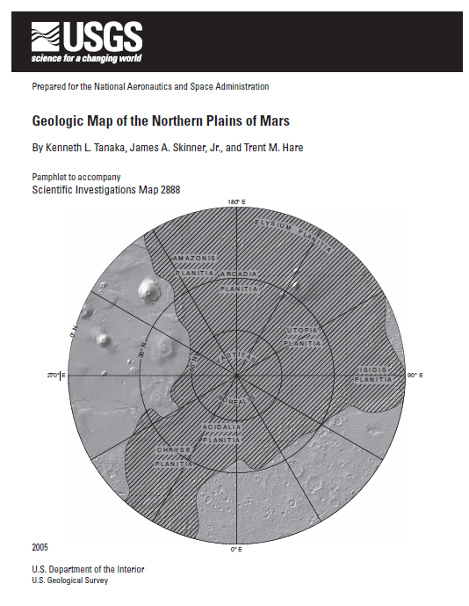
Preferred source
Notes:
PDF title page of pamphlet. Three different presentations of the title.

Slide 10
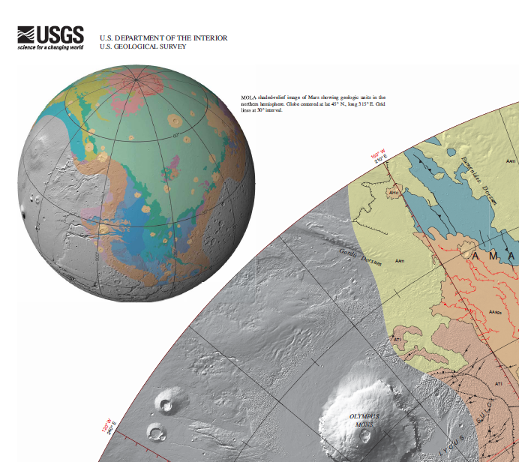
Preferred source
Notes:
Map face

Slide 11
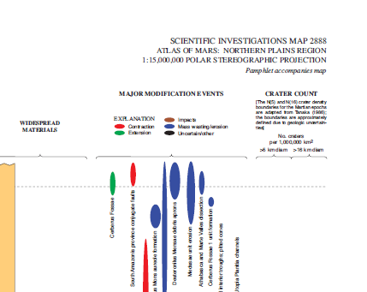
Preferred source
Notes:
Map face

Slide 12
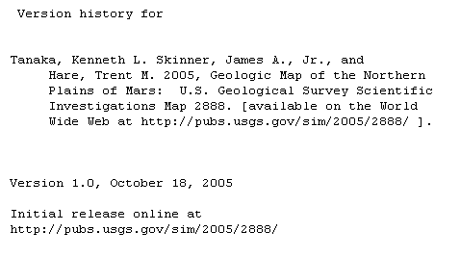
Preferred source
Notes:
Metadata

Slide 13
Title
Transcribe the title proper, parallel title proper and other title information exactly as found on the preferred source.
  245 10 $a Geologic map of the northern plains of Mars
  245 10 $a Paradise lost : $b a poem, in twelve books

Slide 14
Variant title
Variant titles are not core. Record any variant titles you think would help a library user find the resource in a 246 field
    245 10 $a Geologic map of the northern plains of Mars
    246 13 $a Atlas of Mars, northern plains region

Slide 15
Statement of Responsibility
Same as for other formats
  The first statement of responsibility relating to the title proper is core, i.e., required. Others are optional.
  Statements of responsibility relating to the title proper may be taken from any source in the resource, i.e., they do not have to appear with the title proper
Record in 245 subfield $c following space-slash-space

Slide 16

Statement of Responsibility
245 10 $a Geologic map of the northern plains of Mars / $c by Kenneth L. Tanaka, James A. Skinner, Jr., and Trent M. Hare ; prepared for the National Aeronautics and Space Administration.

Slide 17
Statement of Responsibility
245 10 $a Paradise lost : $b a poem, in twelve books / $c the author, John Milton.

Slide 18
Edition Statement
Transcribe any edition statement you find.
245 10 $a Geologic map of the northern plains of Mars / $c by Kenneth L. Tanaka, James A. Skinner, Jr., and Trent M. Hare ; prepared for the National Aeronautics and Space Administration.
250 $a Version 1.0.
Notes:
A couple of examples of music edition statements.

Slide 19
Publication Statement
Record publication information as you find it (or supply)
RDA: record the information about the digital resource
245 10 $a Geologic map of the northern plains of Mars / $c by Kenneth L. Tanaka, James A. Skinner, Jr., and Trent M. Hare ; prepared for the National Aeronautics and Space Administration.
264 _1 $a [Reston, Virginia] : ǂb U.S. Department of the Interior, U.S. Geological Survey, $c 2005.

Slide 20
Publication Statement
Record publication information as you find it (or supply)
PCC Provider-neutral standard when cataloging reproductions: record the information about the original
  245 10 $a Paradise lost : $b a poem, in twelve books / $c the author, John Milton.
  264 _1 $a London : $b Printed for John Sharpe, Picadilly, $c MDCCCXXI [1821]
  264 _3 $a Chiswick : $b C. Whittingham

Slide 21
Extent (3.4.1)
Record the number of units with an appropriate term from the computer carrier type list in 3.3.1.3
    300 $a 3 computer discs
    300 $a 1 computer tape cartridge
    300 $a 1 online resource
Or use a term in common usage
    300 $a 1 DVD-ROM
Notes:
Go to 3.4.3, then 7.20.1.3

Slide 22
Extent (3.4.1.7.5)
If an online resource parallels a print format, specify the number of subunits according to the instructions for that format (3.4.2-3.4.5)
  245 10 $a Geologic map of the northern plains of Mars / $c by Kenneth L. Tanaka, James A. Skinner, Jr., and Trent M. Hare ; prepared for the National Aeronautics and Space Administration.
  300 $a 1 online resource (1 map)
  300 $a 1 online resource (ii, 27 pages)
  245 10 $a Paradise lost : $b a poem, in twelve books / $c the author, John Milton. 300 $a 1 online resource (2 volumes)
Notes:
Go to 3.4.3, then 7.20.1.3

Slide 23
Illustrative and Color Content
(RDA 7.15, 7.17)
Record if present
Record in subfield $b of 300, following a colon
  245 10 $a Geologic map of the northern plains of Mars / $c by Kenneth L. Tanaka, James A. Skinner, Jr., and Trent M. Hare ; prepared for the National Aeronautics and Space Administration.
  300 $a 1 online resource (1 map) : $b color
  300 $a 1 online resource (ii, 27 pages)
  245 10 $a Paradise lost : $b a poem, in twelve books / $c the author, John Milton.
  300 $a 1 online resource (2 volumes) : $b illustrations
Notes:
Read 7.15 and 7.17. together

Slide 24
Dimensions (3.5)
Record dimensions according to the appropriate format in 3.5.1.4.
    300 $a 1 computer disc ; $c 4 3/4 in.
Do not record this element for remote-access resources
Notes:
Everyone open to 3.5.1.4. The preferred unit of measure is metric

Slide 25
Record content, media, and carrier type (3.2, 3.3, 6.9)
    336 $a text $2 rdacontent
    337 $a computer $2 rdamedia
    338 $a computer disc $2 rdacarrier
    336 $a cartographic image $2 rdacontent
    337 $a computer $2 rdamedia
    338 $a online resource $2 rdacarrier
Notes:
Some possible combinations for digital resources

Slide 26
Digital File Characteristic (3.19)
Record in 347
  File type in $a
    347 $a audio file
    347 $a text file
    347 $a image file
  Encoding format in $b
    347 $b PDF
    347 $b HTML
    347 $b TIFF
    347 $b WAV
Notes:
Everyone look at 3.19.

Slide 27
Digital File Characteristic (3.19)
End the 347 field with $2 rda if you’ve used the vocabulary prescribed by RDA.
  245 10 $a Geologic map of the northern plains of Mars / $c by Kenneth L. Tanaka, James A. Skinner, Jr., and Trent M. Hare ; prepared for the National Aeronautics and Space Administration.
  347 $a image file $a text file $b HTML $b PDF $2 rda
  245 10 $a Paradise lost : $b a poem, in twelve books / $c the author, John Milton.
  347 $a image file $b PDF $2 rda
Notes:
Everyone look at 3.19. The Falla recording is not digital and so this element will not be recorded.

Slide 28
Other elements
Include other elements as appropriate to the resource.
    245 10 $a Geologic map of the northern plains of Mars / $c by Kenneth L. Tanaka, James A. Skinner, Jr., and Trent M. Hare ; prepared for the National Aeronautics and Space Administration.
    255 $a Scale 1:15,000,000 ; $b Polar stereographic projection
Notes:
For example, for a digital map, include scale statement, projection of cartographic content. You might also include sound characteristic elements, video characteristic elements, etc.

Slide 29
Series Statement
Record series statement if present on the item (no different from any other format)
    245 10 $a Geologic map of the northern plains of Mars / $c by Kenneth L. Tanaka, James A. Skinner, Jr., and Trent M. Hare ; prepared for the National Aeronautics and Space Administration.
    490 1_ $a Scientific investigations map ; $v 2888

Slide 30
Notes
Record notes as appropriate.
  source of title (RDA 2.20.2, MARC 500)
    500 $a Title from title screen.
  system requirements (RDA 3.20, MARC 538)
    538 $a Requires RTI Series 500 CD-ROM DataDrive.
  basis for identification and date of viewing (RDA 2.20.13, MARC 588)
    588 $a Description based on print version record.
    588 $a Description based on PDF title page, viewed 29 October 2012.
Notes:
A few examples of typical notes for digital resources. No notes are core in RDA, but form of musical notation is core for LC and PCC.

Slide 31
Notes
    245 10 $a Geologic map of the northern plains of Mars / $c by Kenneth L. Tanaka, James A. Skinner, Jr., and Trent M. Hare ; prepared for the National Aeronautics and Space Administration.
500 $a Relief shown by shading.
500 $a Accompanied by pamphlet (separate PDF file).
500 $a Includes text, ancillary maps, and chart.
504 $a Includes bibliographical references (pages 19-25 of pamphlet).
588 $a Description based on title screen, viewed 29 October 2012.
Notes:
A few examples of typical notes for music.

Slide 32
Notes
    245 10 $a Paradise lost : $b a poem, in twelve books / $c the author, John Milton.
    588 $a Description based on PDF title page, viewed 29 October 2012.
Notes:
A few examples of typical notes for music.

Slide 33
Identifier for the manifestation (2.15)
Record identifiers
  ISBN in 020
    020 $a 4113002703
    245 10 $a Geologic map of the northern plains of Mars / $c by Kenneth L. Tanaka, James A. Skinner, Jr., and Trent M. Hare ; prepared for the National Aeronautics and Space Administration.
Notes:
A plate number is a number that appears at the bottom of each page of a music score.

Slide 34
URL (4.6)
For remote access resources, record the URL in 856 $u
For provider-neutral records, record all URLs.
        245 10 $a Geologic map of the northern plains of Mars / $c by Kenneth L. Tanaka, James A. Skinner, Jr., and Trent M. Hare ; prepared for the National Aeronautics and Space Administration.
        856 40 $u http://purl.access.gpo.gov/GPO/LPS92955
        245 10 $a Paradise lost : $b a poem, in twelve books / $c the author, John Milton.
        856 40 $3 HathiTrust Digital Library (Harvard University copy) $u http://catalog.hathitrust.org/api/volumes/oclc/79617337.html
        856 40 $3 Internet Archive (Brigham Young University copy) $u http://archive.org/details/paradiselostpoem1821milt

Slide 35
Record Relationships
Record the principal creator.
    100 1_ $a Tanaka, Kenneth L., $e cartographer.
    245 10 $a Geologic map of the northern plains of Mars / $c by Kenneth L. Tanaka, James A. Skinner, Jr., and Trent M. Hare ; prepared for the National Aeronautics and Space Administration.
    100 1 $a Milton, John, $d 1608-1674, $e author.
    245 10 $a Paradise lost : $b a poem, in twelve books / $c the author, John Milton.

Slide 36
Record Relationships
Record the relationship of the resource to the work embodied in it.
    100 1_ $a Tanaka, Kenneth L., $e cartographer.
    245 10 $a Geologic map of the northern plains of Mars / $c by Kenneth L. Tanaka, James A. Skinner, Jr., and Trent M. Hare ; prepared for the National Aeronautics and Space Administration.
    100 1 $a Milton, John, $d 1608-1674, $e author.
    245 10 $a Paradise lost : $b a poem, in twelve books / $c the author, John Milton.
Notes:
Reminder: this is done by embedding the authorized access point for the work in the record.
We’ve talked about the LC policy of not explicitly including an authorized access point for the work if the title proper in the 245 is exactly the same as the preferred title of the work. This is the case here.

Slide 37
Record Relationships
Record other relationships you consider important.
    245 10 $a Geologic map of the northern plains of Mars / $c by Kenneth L. Tanaka, James A. Skinner, Jr., and Trent M. Hare ; prepared for the National Aeronautics and Space Administration.
    700 1_ $a Skinner, James A., $c Jr. $q (James Albert) , $e cartographer.
    700 1_ $a Hare, Trent M., $e cartographer.
    710 2_ $a Geological Survey (U.S.), $e publisher.
    710 1_ $a United States. ǂb National Aeronautics and Space Administration, $e sponsoring body.
    830 _0 $a Scientific investigations map ; $v 2888.
Notes:
I checked the authority file for all these forms.

Slide 38
Exercise
Work together to catalog digital resources workshop participants have brought, if any.

Slide 39
Module 16
Describing Digital Resources
Questions?
RDA Training
University of Nevada, Reno
February 2013

Slide 40
This Presentation is available at
http://net.lib.byu.edu/~catalog/people/rlm/RDAReno201302/index.htm
For further information
contact Robert L. Maxwell
robert_maxwell@byu.edu

